Slide 1
Telehealth Education for Privileges
Notes:
Suffolk County’s Only….
Level 1 Trauma Center
Level 4 Regional Perinatal Center
Children’s Hospital/Pediatric ED
Burn Center
Kidney Transplant Program
Bone Marrow Transplant Program
State-Designated AIDS Center
State-Designated Comprehensive Psychiatric Emergency Program (CPEP)
ALS Center of Excellence
VAD Program

Slide 2
Telehealth Strategy
Mission: To integrate Telehealth practice into the clinical workflow of patient care in connecting providers and patients to provide quality, convenient and efficient care across the Stony Brook Health System and Beyond
Telehealth Clinical Excellence
Telehealth Regional Standing
Patient-Centered Care
Community Leader
Academic & Research Excellence
Our Values → ICARE: Integrity, Compassion, Accountability, Respect, Excellence

Slide 3
Privileging
Telehealth practice aligns with your clinical privileges
Current credentialing and licensing for telehealth follows medicine credentialing and licensing laws
There is no “National” Medical License
You can only provide telehealth services for the medical practice you are credentialed and licensed to perform
Utmost professional behavior and appearance must be adhered to in Telehealth practice
Telehealth practice is defined by where the PATIENT is and can only be delivered to a patient in a state where you are licensed to practice

Slide 4
Know the Rules
Physicians Practice Under State Licenses (New York) and must abide by New York State Law
CMS or Medicare policies are dictated by Federal Law (Federal Register) and Reimbursement is written in the Physician Fee Schedule
Clinicians must be knowledgeable about Both and Make sure not to Violate either
It is best practice to ask Compliance (Especially before performing new services/ billing new codes)

Slide 5
Definitions
Telemedicine
The delivery of clinical health care services by means of real time two-way electronic audio-visual communications
Facilitate the assessment, diagnosis, consultation, treatment, education, care management and self-management of a patient's health care
Patient is located at a separate “originating” site and the health care provider is at a distant site
Telehealth
The use of electronic information and communication technologies to deliver health care services
Includes the assessment, diagnosis, consultation, treatment, education, care management and/or self-management of a patient.
Does Not include delivery of services by means of audio-only telephone communication, fax, or electronic messaging alone,
Can be used in conjunction with telemedicine, store and forward technology or remote patient monitoring.
NY Consolidated Law Service Public Health Sec. 2805-u.
NY Public Health Law Article 29 – G Section 2999-cc

Slide 6
Scope
Telehealth and Telemedicine are Often Used Interchangeably
Both describe the use of medical information exchanged via electronic communications to improve the patients’ health status
Telemedicine is usually associated with direct patient clinical services
Telehealth is usually associated with a broader
definition of remote health care services
What Telehealth/Telemedicine Is Not:
Radiology Standard Practice (i.e. Remote Chest Xray/ MRI reads)
A substitute for critical patients requiring an In-person evaluation
Telehealth
Telemedicine

Slide 7
Sites and Hub and Spoke
“Distant site” means a site at which a telehealth provider is located while delivering health care services by means of telehealth.
“Originating site” means a site at which a patient is located at the time health care services are delivered to him or her by means of telehealth.
Originating sites shall be limited to: (a) facilities licensed under articles twenty-eight and forty of this chapter; (b) facilities as defined in subdivision six of section 1.03 of the mental hygiene law; (c) certified and non-certified day and residential programs funded or operated by the office for people with developmental disabilities; (d) private physician’s or dentist’s offices located within the state of New York; (e) any type of adult care facility licensed under title two of article seven of the social services law; (f) public, private and charter elementary and secondary schools, school age child care programs, and child day care centers within the state of New York; and (g) the patient’s place of residence located within the state of New York or other temporary location located within or outside the state of New York.
https://www.nysenate.gov/legislation/laws/PBH/2999-CC
Hub
Distant Site
Spoke
Originating Site
Spoke
Originating Site
Spoke
Originating Site
Spoke
Originating Site
Spoke
Originating Site
Hub - The provider providing telehealth consultation
Spoke - The patient receiving telehealth services

Slide 8
Classifications
Asynchronous
(Store and Forward)
Patient or physician collects data: medical history, images, pathology, reports and then sends it to a specialist physician for diagnostic and treatment expertise
Store and Forward can be done through a Patient Portal, electronic messaging, or through special software
This is popular with specialists for example in Dermatology and Ophthalmology , among others
Usually omits Standard Radiology Practices (Remote reading of an Xray)
Remote Patient Monitoring
(RPM)
Remote patient monitoring (RPM) uses digital technologies to collect medical and other forms of health data from individuals in one location and electronically transmit that information securely to health care providers in a different location for assessment and recommendations.
This type of service allows a provider to continue to track healthcare data for a patient once released to home or a care facility, (often reducing readmission rates or need for emergency room visits)
Monitoring programs can collect a wide range of health data from the point of care, such as vital signs, weight, blood pressure, blood sugar, blood oxygen levels, heart rate, and electrocardiograms.
Mobile Health
(mhealth)
Mobile health, or mHealth, is a rapidly evolving aspect of technology-enabled health care.
Smart phones and portable monitoring sensors that transmit information to providers, as well as dedicated application software (apps) which are downloaded onto devices, are used in mHealth. Given its recent emergence into the telehealth field, policies governing the use of this technology are continually being shaped.
The Food and Drug Administration (FDA), the Federal Trade Commission (FTC), and the Federal Communication Commission (FCC) all share jurisdiction over some part of the federal regulation of mHealth.
From: Center for Connected Health Policy: The National Telehealth Policy Resource Center

Slide 9
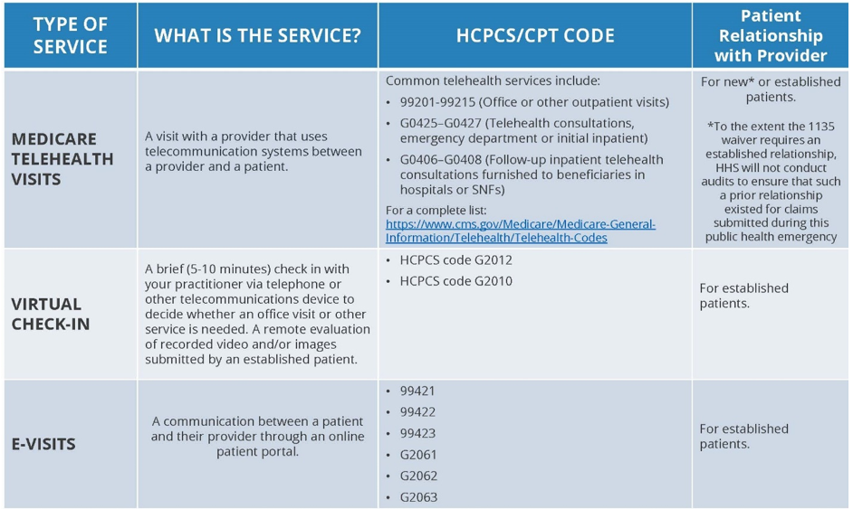
Medicare Definitions Are Unique
Notes:
https://www.cms.gov/newsroom/fact-sheets/medicare-telemedicine-health-care-provider-fact-sheet

Slide 10
Steps You Must Take
Only provide telehealth services for the medical practice you are credentialed and licensed to perform!
Utmost professional behavior and appearance must be adhered to in Telehealth practice
“Webside Manner” instead of Bedside Manner
Ensure proper lighting and be attentive to what is in your background that the patient will see
Practice warm and cordial virtual communication techniques
Make sure you have the patient MRN, name, and other patient details available to you before starting the encounter (The Video software is not linked to the EMR, therefore prepare for proper documentation on the right patient in advance).
Ask for the Patient’s Consent verbally to have a telehealth visit and document the patient’s approval
Document in your note that you used Live-Two-way Audio and Visual to evaluate the Patient

Slide 11
Data Security and Safety
HIPAA (Health Insurance Portability and Accountability Act)
Patient data must be secure at all times
Remote Patient Monitoring may limit confidentiality
Firewalls must ensure security
Telehealth providers must abide by patient safety laws
Consent is required for accessing patient data
Written or electronic consent often needed ex: Health Information Exchanges

Slide 12
Patient Confidentiality/Consent
Obtain written permission from the patient before transmitting any protected health information
Require all staff involved in the Telehealth encounter to execute confidentiality agreements
Allow only designated professionals to disclose health related information
Transmit patient/client data on an as-needed basis
Ensure the patient/client is aware and grants approval for all personnel participating in the consultation
Prohibit the use of unauthorized cameras and cellular telephones in the examination room
Re-iterate the right for the patient to revoke consent and to seek in person care.
Document names, credentials, organizational affiliations and locations of the various health professionals involved in Telehealth activity
Make sure to describe and document that you discussed the potential benefits and risks of a Telehealth encounter
Explain to the patient how care is to be documented and accessed
Schedule telehealth encounters in a room that is suitably enclosed or private
Discuss with the patient a contingency plan in the event of a problem during the procedure (loss of connectivity etc.)
Document the names of those responsible for ongoing care
Mandate HIPAA practices

Slide 13
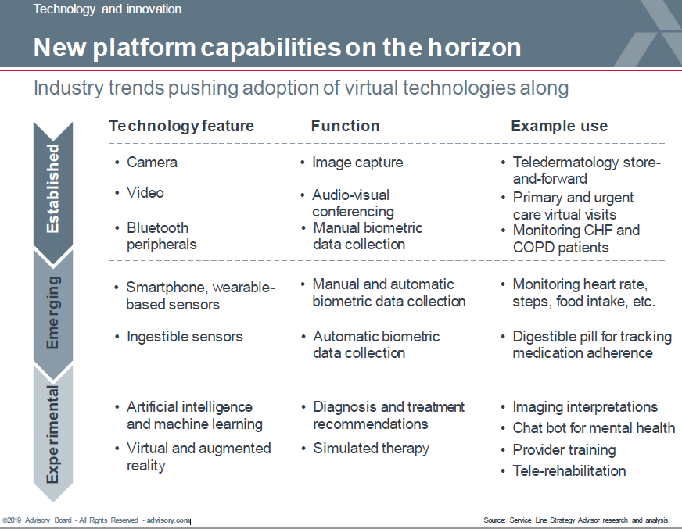
Final Notes
Not All Telehealth Practice will be Reimbursable
Discuss billing strategy with your administrator
Must Discuss Any Implementation with Department Administrator
Must Adhere to Any Additional Organizational, Regulatory, or Accreditation
Requirements Necessary by Department
Inform Compliance Before Use and Consider Getting Training

Slide 14
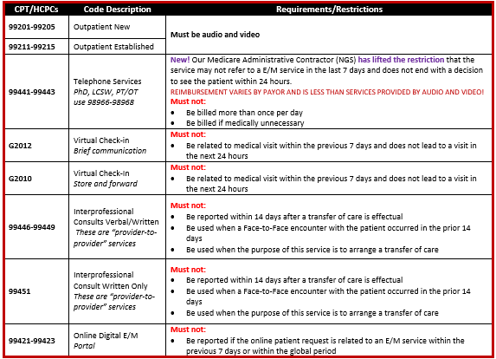
From CPMP Compliance department Find the list of all CMS approved Telehealth services here.
These are the most commonly used virtual and digital medicine codes
Unless stated otherwise, other services included on the list must be furnished using audio and video equipment permitting two-way, real-time interactive communication between the patient and provider.
Telehealth services require the following documentation:
Patient consent for treatment
A statement that the service was provided using telemedicine
Location of the patient and provider i.e. Home/Office
From: V8 Virtual Care Summary
The use of Telehealth in the Inpatient setting at SBUH is limited to consulting services providing care for COVID-19 patients only and only when appropriate. All other consults must be rendered in person.
Outpatient/Office Telehealth services are limited to encounters when the provider is in their clinic/office.
All providers will have their documentation reviewed by Compliance as part of the privileging process

Slide 15
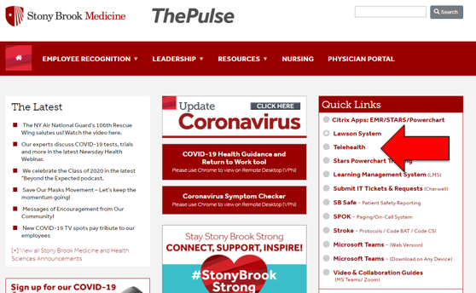
Resources
Northeast Telehealth Resource Center
http://netrc.org/new-york/
American Telemedicine Association
http://thesource.americantelemed.org/home
Middle Telehealth Resource Center
http://www.matrc.org/general-telehealth-resources
Center for Connected Health Policy
http://www.cchpca.org
New York State Department of Health
https://www.health.ny.gov
Centers for Medicare and Medicaid Services
https://www.cms.gov
Stony Brook Medicine Telehealth Policy #LD0112

Slide 16
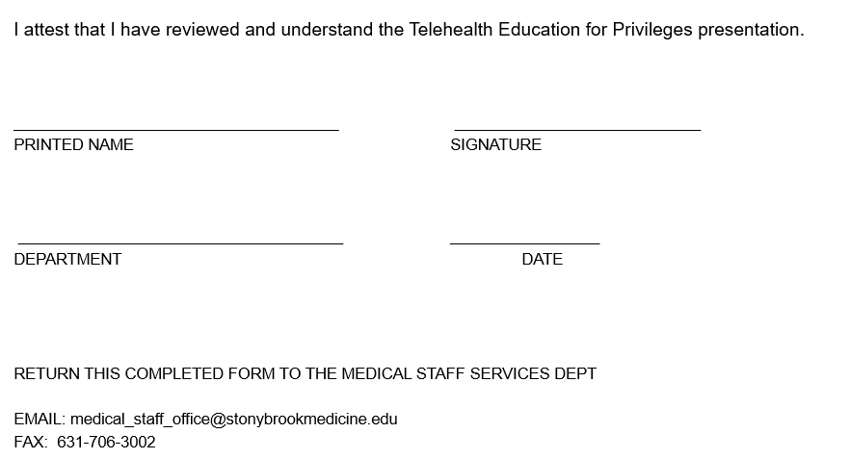
ATTESTATION

