Slide 1
Use of Restraints
Required Education for Providers
Notes:
Updated January 2019

Slide 2
Course Goals
After completing this course, you should be able to:
Define restraint and seclusion
List the risks of restraint and seclusion
Recognize best practices and regulatory standards for the use of restraint and seclusion
SBUH restraint policy is Administrative manual:
PC0008 Restraint and Seclusion

Slide 3
Providers must be trained and competent in the following:
1. How to identify behaviors, events, and situations
that may trigger circumstances that require the
use of restraint or seclusion
How to use nonphysical intervention skills
3. How to use an assessment of the patient’s status
or condition to choose the least restrictive intervention

Slide 4
Restraint is any method for limiting:
• Patient movement
• Patient activity
• A patient’s normal ability to reach parts of his or her own body
Seclusion is the confinement of a patient to an area that they are prevented from leaving.
The decision to use restraint or seclusion is based on the patient’s
behavior. Each patient must be assessed to determine if restraint or
seclusion is needed.
No patient may ever be restrained in any way, in a prone position, as the risk of asphyxiation is high.

Slide 5
Definitions of Restraint Types
Violent/Self-Destructive Patient Restraint Use: The restriction of patient movement in response to severely aggressive, violent, destructive, self-destructive, or suicidal behaviors that place the patient or others in imminent danger. The duration of time for adults 18 years and above may not exceed 2 hours, for children 10-17 years may not exceed 1 hour and for children 9 years and younger 30 minutes at which time a new restraint order is entered or discontinued.
Non-Violent Patient Restraint Use: Restraint used to restrict a patient’s movement as to assist with the provision of medical or surgical care. (i.e. preventing removal of lines and/or tubes). Patient immobilization that is a normal component of a procedure (e.g. MRI, surgery, etc.) is not considered restraint. Restraint orders must be either reordered or discontinued daily.

Slide 6
Use of Seclusion:
Seclusion: The involuntary confinement of a patient alone in a room, under continuous observation or area from which the patient is physically prevented from leaving. Seclusion may be used only for the management of violent or self-destructive behavior that jeopardized the immediate safety of the patient, a staff member or others. Confinement on a locked unit, where the patient is with others, does not constitute seclusion.

Slide 7
Hospital Approved Physical Restraints:
Vest
2. Wrist or wrist and ankle either soft or polyvinyl or neoprene
3. Hand mitt or mitten (only a restraint if tied down)
4. Wrist, ankle and soft chest band (not to be used alone) used
simultaneously is limited to use in psychiatric units
Side rails of bed (when all four side rails are up and the
intention is to restrict the patient to bed)
Enclosure bed (only considered a restraint if all sides are
zipped) NOTE: May be ordered in combination with Vest when OOB to chair.
Physical holds: Holding a patient in a manner that restricts
the patient’s movement against the patient’s will.

Slide 8
Use of restraint has risks.
Therefore, all healthcare facilities should work toward reducing or
eliminating use of restraint. Facilities should:
• Intervene early to avoid later need for restraint
• Find alternatives to restraint
Restraint should be used only when:
• Less restrictive interventions are ineffective
• Clinically justified to promote healing
• Warranted by violent patient behavior that threatens the
physical safety of the patient, staff, or others
Restraint and seclusion should NEVER be used to:
• Discipline a patient
• Make patient care tasks more convenient for staff
• Make a patient do something against his/her will
• Retaliate against a patient
The patient’s rights and safety must be protected during restraint or seclusion.

Slide 9
Non-Violent RestraintS
Restraint or seclusion for non-violent patients must be ordered by a
Physician or LIP :
• Orders must be issued on a case-by-case basis.
• Orders are time-limited.
• PRN (as needed) orders are NEVER acceptable.
• Every day, the physician or LIP who is primarily responsible for the patient must see and re-evaluate the patient before writing a new order. The need for the restraint is documented in the note.

Slide 10
Non-Violent Restraints
Patients who have been placed in restraints by an RN emergently for non-violent reasons must be have an order placed immediately (not to exceed 5 minutes) and be evaluated within one hour and re-evaluated in person by the provider primarily responsible for his or her care every day. Patient must be on One to One Observation as well as restraint until the LIP evaluation (within one hour) is completed.
The evaluation AND documentation must include:
• The patient’s immediate situation
• The patient’s reaction to the intervention
• The patient’s medical and behavioral condition
• The need to continue or terminate the restraint or seclusion
Patients must also be monitored during restraint or seclusion by qualified and trained unit staff according to hospital policy.

Slide 11
Violent/Self-destructive RestraintS
Restraint or seclusion for Violent/Self-destructive patients may be ordered by a
Physician/LIP on a Med/Surg Unit and ONLY by a Physician in a Psychiatric Unit:
• Orders must be issued on a case-by-case basis.
• Patient is on 1:1 observation as long as they are in a violent restraint
• Orders are time limited and restricted to a specific duration based on patient
age: 2 hours for ages 18 and up
1 hour ages 10-17
30 minutes age 9 and younger
• PRN (as needed) orders are NEVER acceptable.
• Every 24 hours or less, the physician who is primarily responsible for the patient must see (face to face) the patient before renewing any more orders and
document their evaluation. i.e. after initial order and face to face evaluation,
renewals may be done but only for 24 hours before re-evaluation the patient.
Orders cannot be renewed on psychiatric services but can renewed, if needed, on other
services.
See slide # 13 &14 for additional requirements for patients in a Psychiatric Unit in Violent/Self-Destructive Restraints and/or Seclusion

Slide 12
a. Actions/behaviors or conditions that indicated the initial and/or
continued use of restraint.
b. Consideration or failure of nonphysical interventions/alternatives.
c. Restraint orders/time of initiation.
d. Patient monitoring/assessment/reassessment.
e. Significant changes in the patient’s condition.
Restraint and seclusion must be documented fully in the patient’s medical record. Documentation i.e. progress note should include:

Slide 13
Potential Physical and psychological issues related to use of Restraints
Positional asphyxiation- During holding of a patient it is important to have another person monitor the patient for signs of respiratory distress, i.e. inability to breath while being held. Release if patient has respiratory distress.
Hanging in a restraint- if a patient is witnessed hanging by their neck in a restraint, it is to be immediately removed (cut off if necessary). Lower patient to the floor, get help and begin CPR as needed.
Circulatory compromise- if a restrained limb is blue, or cold, or painful to patient, then immediately release the restraint and call for help.
Psychological distress r/t restraint- if patient communicates feelings of helplessness or hopelessness while in restraint, release the patient from the restraint if appropriate and consider a consult to pyschiatry.
Bleeding- if a patient is found to be bleeding, release restraint, apply pressure to the site and call for help.
Choking- if a patient is found to be choking on food/fluids or any foreign body i.e. medications…release restraints, place the head of the bed up and administer Heimlich maneuver if necessary. Call for assistance.
If a patient is found unconscious, release restraints, call for help, open airway, and begin CPR if necessary.
Universal Precautions apply to all patient contacts

Slide 14
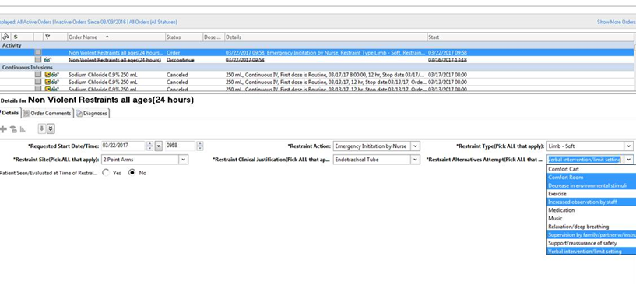
Powerchart order entry
This button not constitute a note.
Non-Violent Restraint order- all fields are required. If you have already seen the patient, choose yes. A screen will pop up, click continue and the Face to Face Note will appear. Complete this and your face to face note is done. If you click no, you need to add THIS specific note when you do see the patient.
Restraint orders are final once signed and can no longer be modified. Renewals need all required fields.

Slide 15
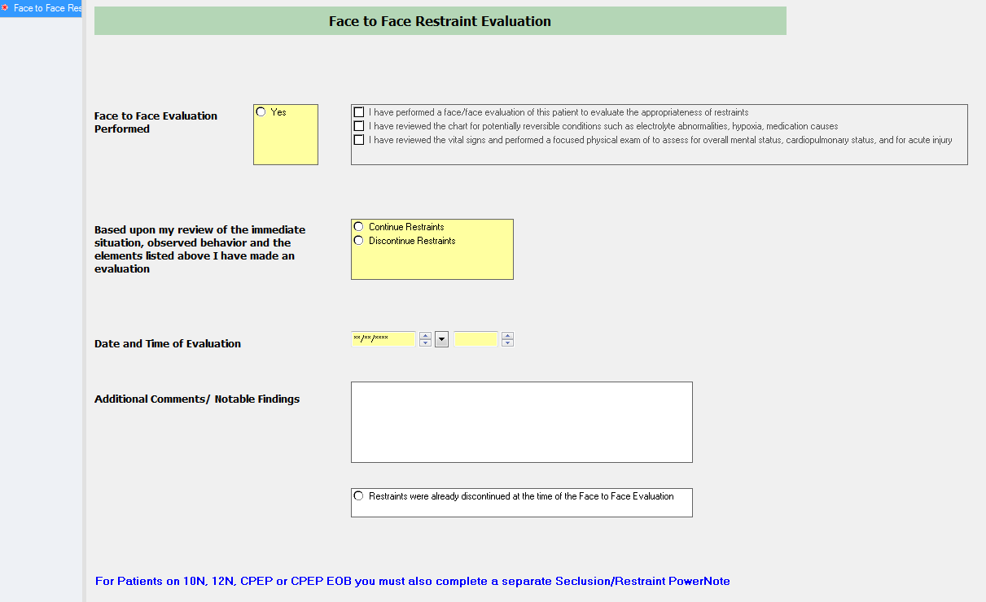
This is the required face to face form that pops up when you click “yes and choose continue” from the order for both Non-Violent and Violent Self Destructive Restraint orders.

Slide 16
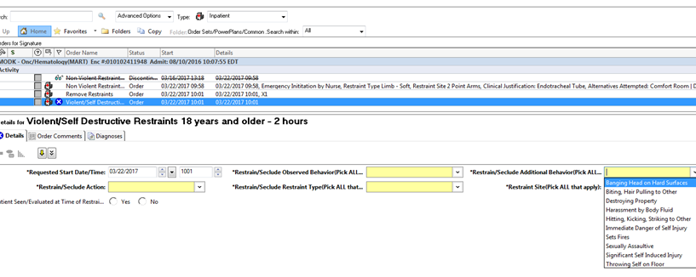
Powerchart order entry
This button not constitute a note.
Violent-Self Destructive Restraint order- all fields are required. Please make sure if you have If you have already seen the patient, choose yes. A screen will pop up, click continue and the Face to Face Note will appear. Complete this and your face to face note is done. If you click no, you need to add THIS specific note when you do see the patient.
UNLESS the patient is on a behavioral health unit (CPEP, 12 N or 10N).
Restraint orders are final once signed and can no longer be modified. Renewals need all required fields. Behavioral Health units must always have a new (initiation order for all episodes).
This is the end of the presentation for MD/LIP’s that do not work in psychiatric units.

Slide 17
Additional Requirements for Restraints on a Psychiatric Unit
More ordering requirements on a Psychiatric Unit:
Physician face to face must occur within 20 minutes. Under the very rare circumstance when this is impossible (e.g., physician is addressing life threatening situation with another patient), the RN is to place a note in the chart explaining the circumstance and the physician must also document the reason for the delay at the time the evaluation is conducted.
Renewals are not used on psychiatric units. Once an order is about to expire the patient should be afforded the opportunity for release, if imminent danger is still present, a new initial order is required as is all documentation and another face to face evaluation by the ordering physician.

Slide 18
Additional Requirements for Restraints on a Psychiatric Unit
Debriefing on a Psychiatric Unit:
The patient is informed of the behavioral criteria for discontinuation of the restraint. Debriefings occur as follows:
Patient Debriefing – Occurs as soon as possible after the episode with the patient for the purpose of assessing the patient’s needs and the patient’s response to the event. What might have been prevented and how to prevent future episodes.
2. Post-acute Event Analysis Staff Debriefing – Occurs as soon as possible
after the episode with involved staff for the purpose of assessing the patient
and staff members’ immediate needs. What might have been prevented
and how to prevent future episodes.
Formal debriefing with leadership – Occurs as soon as possible after the
episode (within 24 hours of episode or the next business day) to delineate
details of the episode, elicit participants feelings regarding the events, and
identify any operational and/or training issues that may require attention.

